Slide 1



Hospital Analytics Dashboard
View in Power BI
Last data refresh:
7/7/2025 5:24:44 AM UTC
Downloaded at:
7/7/2025 5:29:50 AM UTC

Slide 2
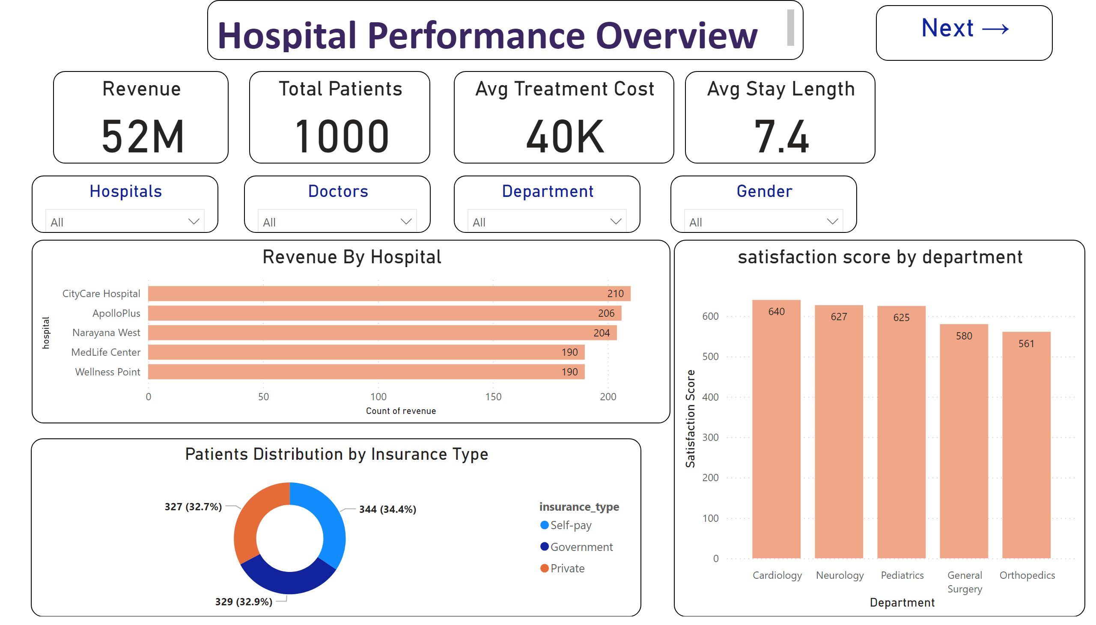
Hospital Performance Overview
Notes:
textbox
No alt text provided
Total Patients
No alt text provided
Revenue
No alt text provided
Avg Treatment Cost
No alt text provided
Avg Stay Length
No alt text provided
Revenue By Hospital
No alt text provided
Gender
No alt text provided
Patients Distribution by Insurance Type
No alt text provided
Hospitals
No alt text provided
Doctors
No alt text provided
Department
No alt text provided
satisfaction score by department
No alt text provided
Next →
No alt text provided

Slide 3
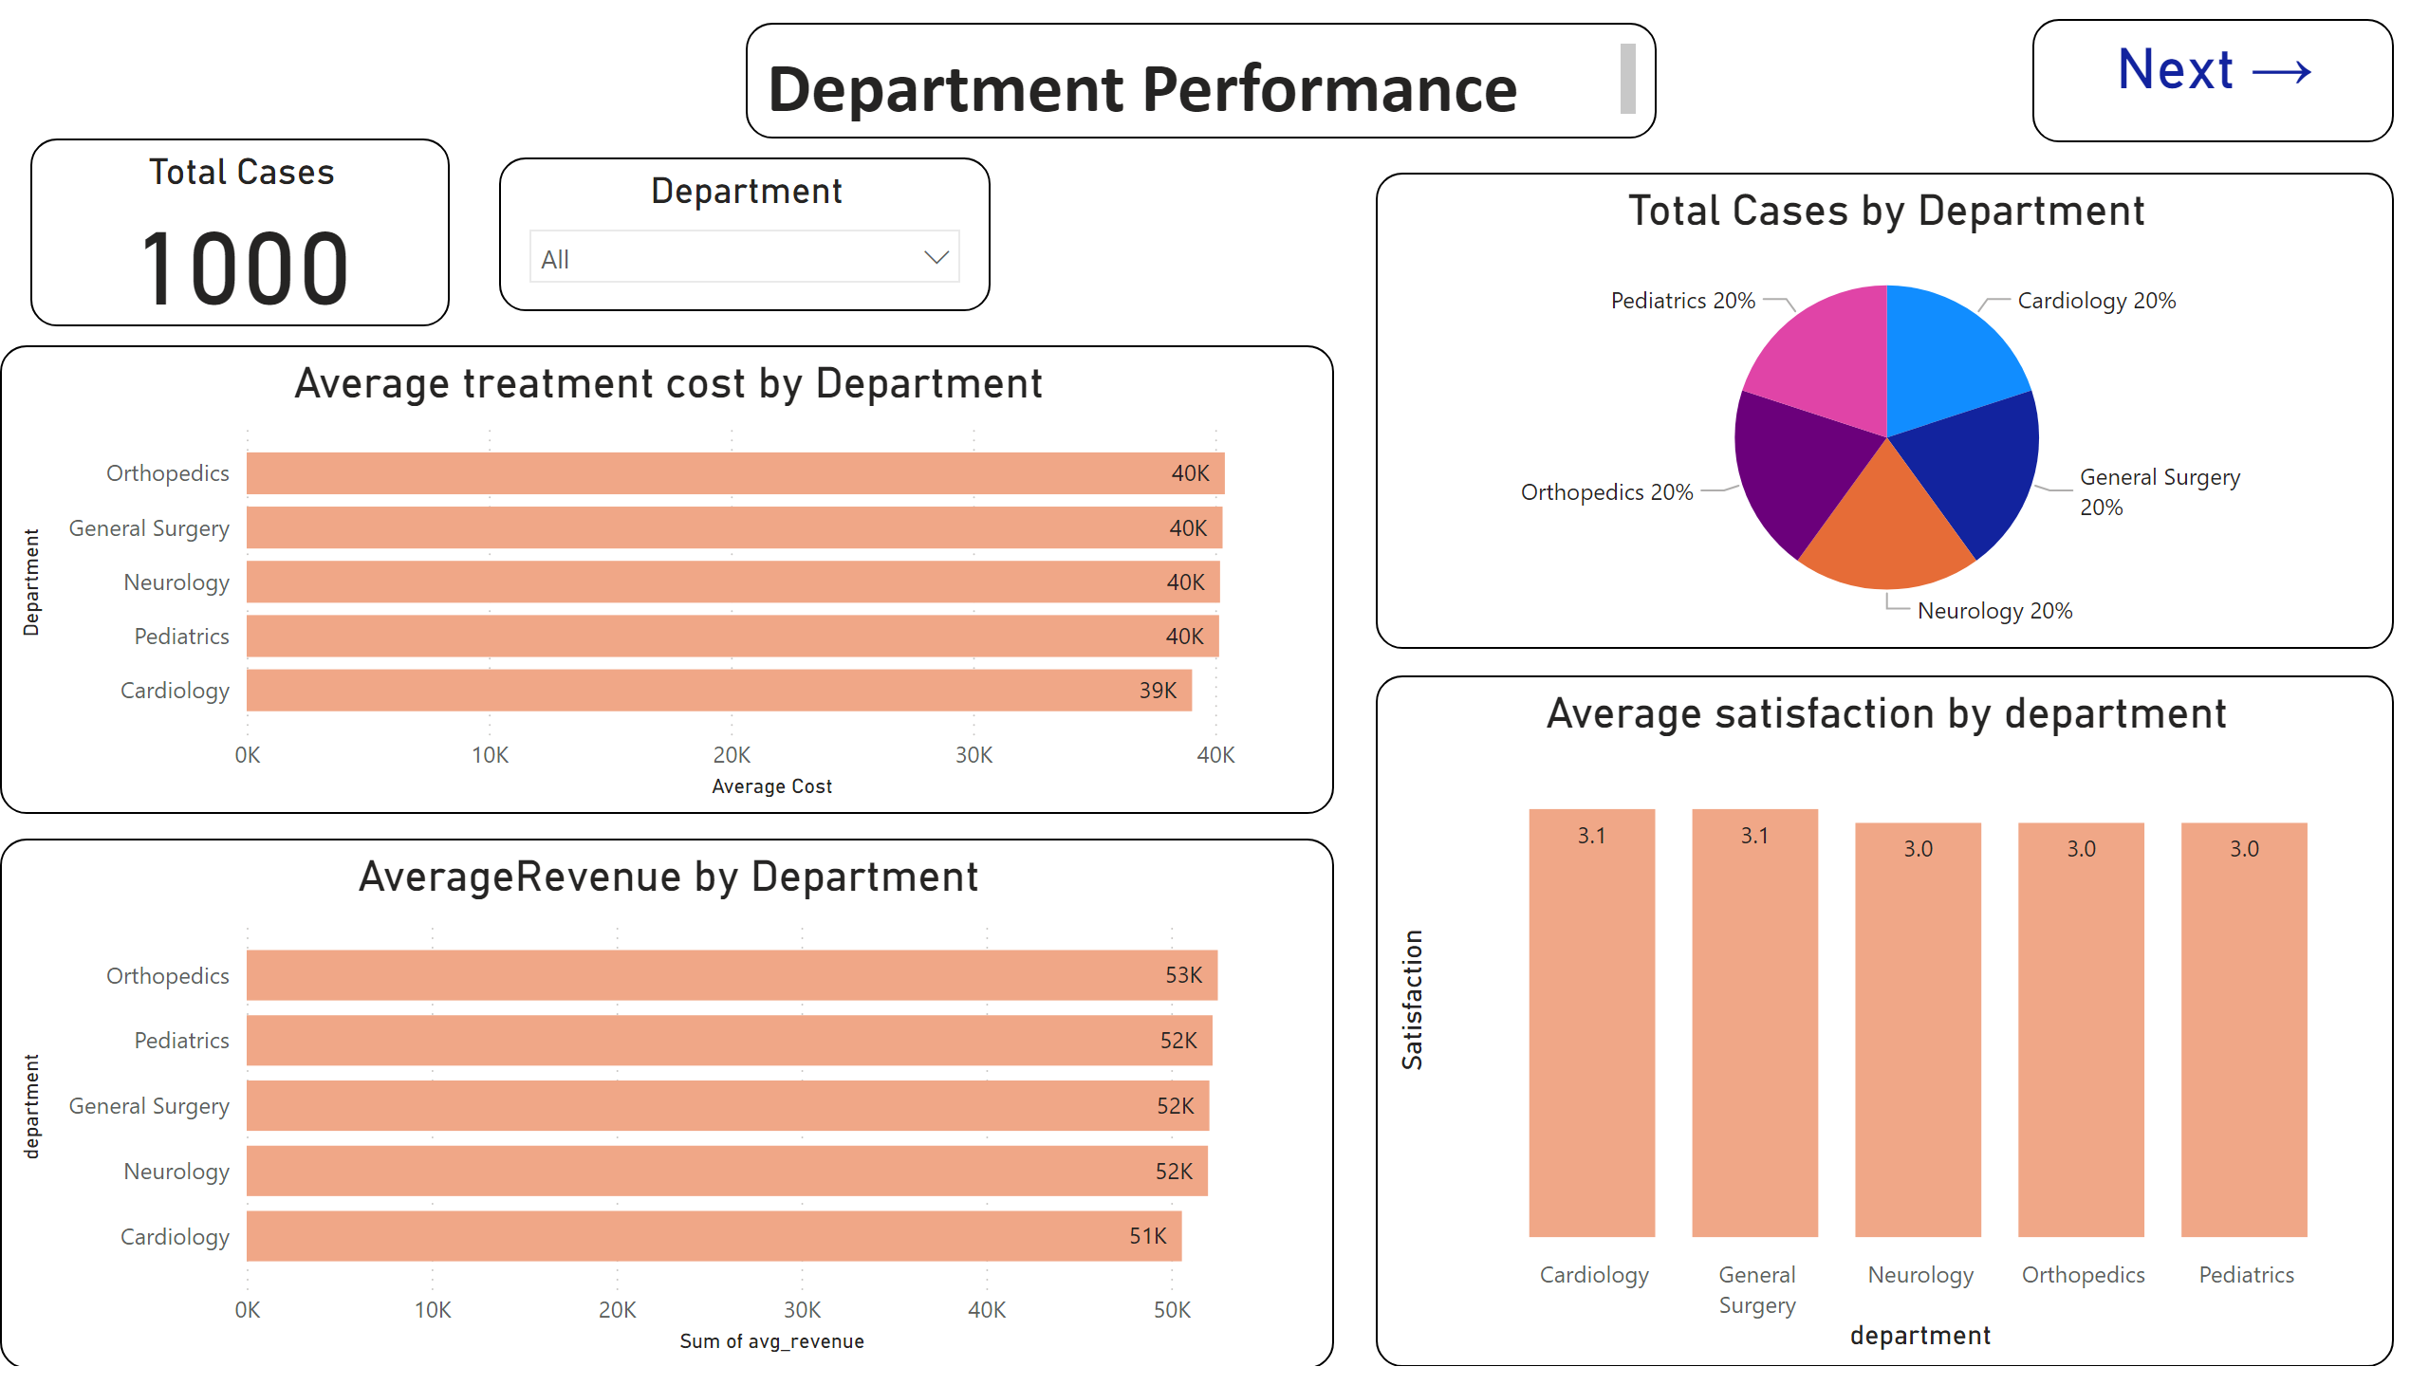
Department Performance
Notes:
Total Cases
No alt text provided
Average treatment cost by Department
No alt text provided
AverageRevenue by Department
No alt text provided
Average satisfaction by department
No alt text provided
Total Cases by Department
No alt text provided
Department
No alt text provided
slicer
No alt text provided
slicer
No alt text provided
textbox
No alt text provided
Next →
No alt text provided

Slide 4
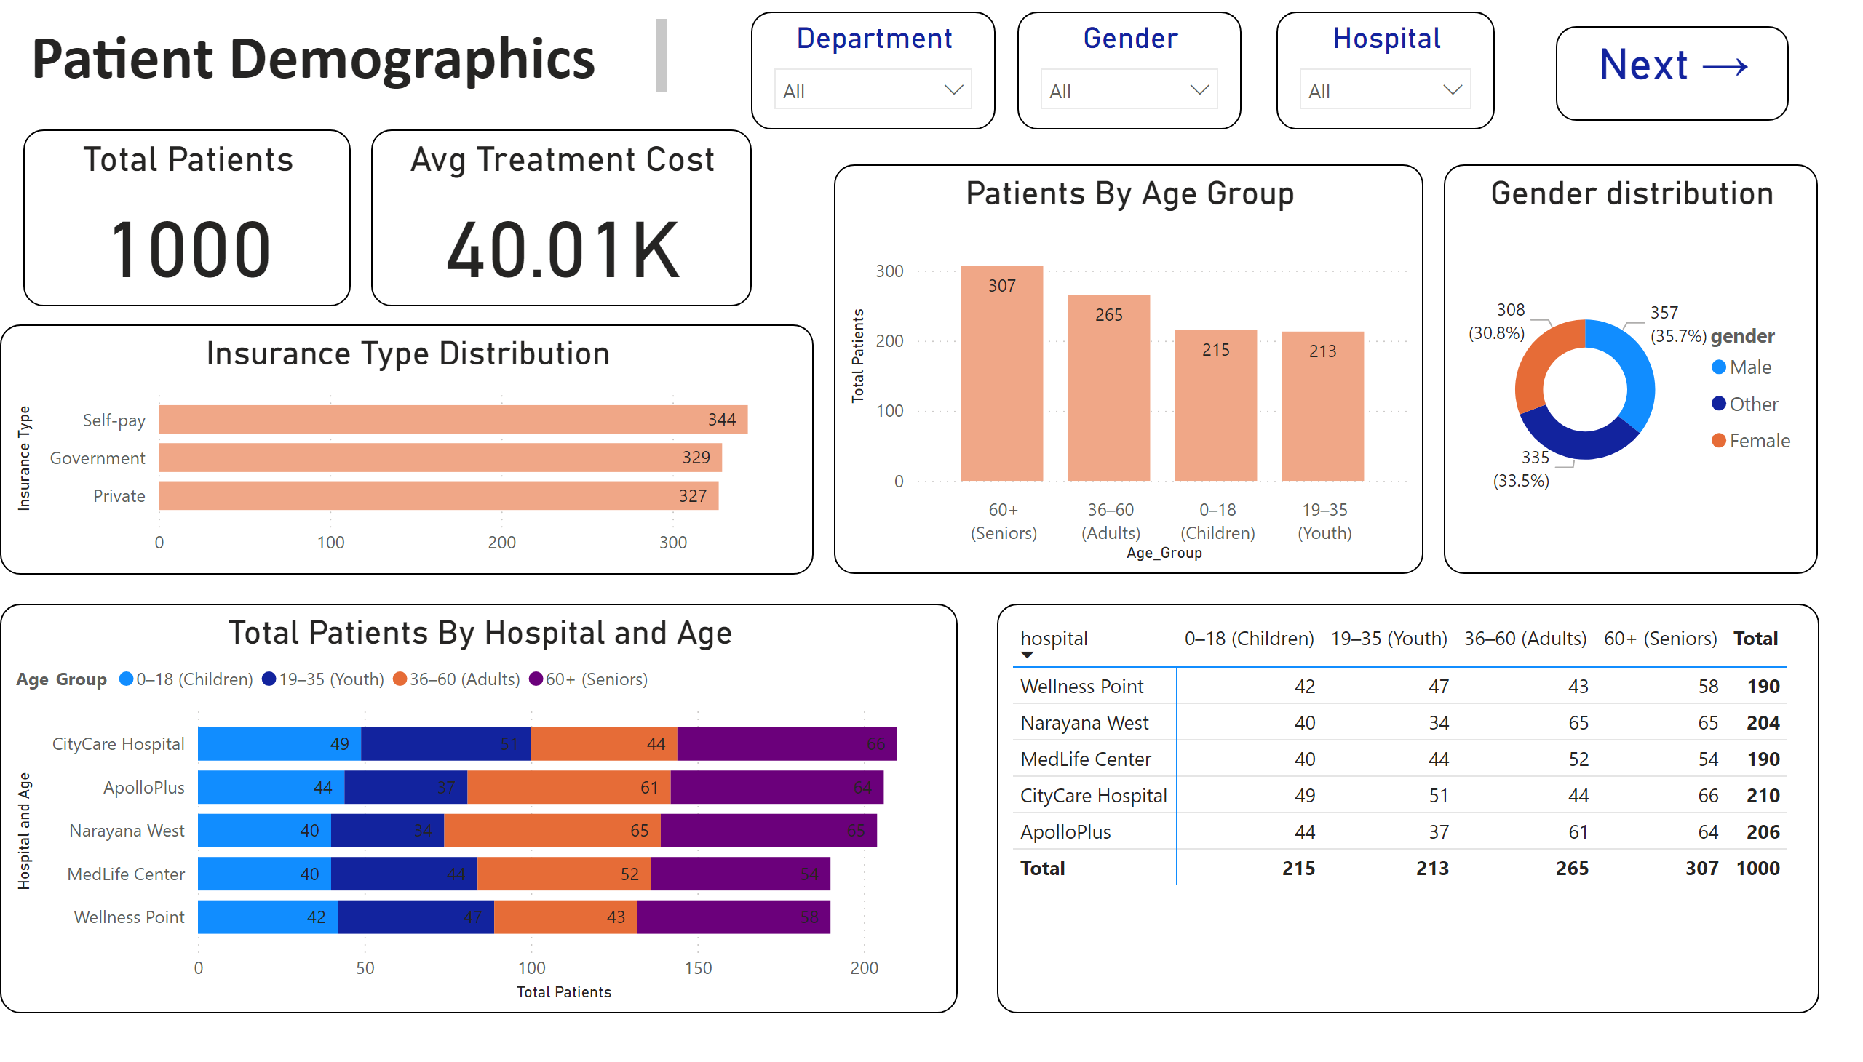
Patients Demographics
Notes:
Gender distribution
No alt text provided
Insurance Type Distribution
No alt text provided
Patients By Age Group
No alt text provided
Hospital
No alt text provided
Gender
No alt text provided
Department
No alt text provided
Total Patients
No alt text provided
Total Patients By Hospital and Age
No alt text provided
pivotTable
No alt text provided
textbox
No alt text provided
Avg Treatment Cost
No alt text provided
Next →
No alt text provided

Slide 5
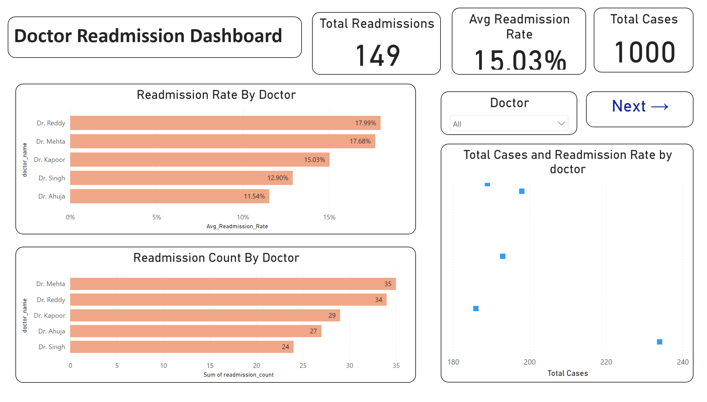
Doctor Readmission
Notes:
textbox
No alt text provided
Total Cases
No alt text provided
Total Readmissions
No alt text provided
Avg Readmission Rate
No alt text provided
Doctor
No alt text provided
Readmission Count By Doctor
No alt text provided
Readmission Rate By Doctor
No alt text provided
Total Cases and Readmission Rate by doctor
No alt text provided
Next →
No alt text provided

Slide 6
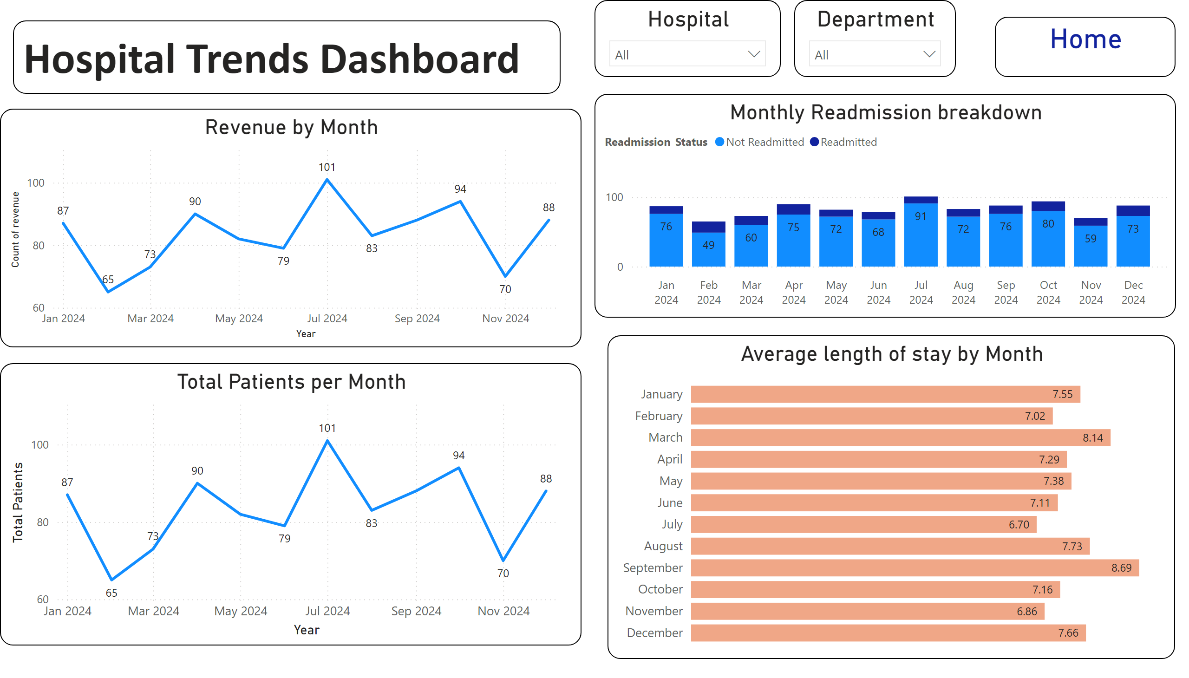
Hospital Trends
Notes:
textbox
No alt text provided
Revenue by Month
No alt text provided
Total Patients per Month
No alt text provided
Hospital
No alt text provided
Average length of stay by Month
No alt text provided
Monthly Readmission breakdown
No alt text provided
Department
No alt text provided
Home
No alt text provided

